Slide 1
Types of Letters

Slide 2
Different Types of Letters
Letter of Inquiry
Cover Letters
Good News Letters
Bad-News Letters
Complaint Letters
Adjustment Letters
Sales Letters

Slide 3
Criteria for Letter of inquiry
To receive the information you need, write an effective letter of inquiry.
Clarify your intent in the introduction in one to three sentences.
Specify your needs. Ask precise answers
Conclude precisely.

Slide 4
Could Mr. Jindal attend the AAP party central meeting on Thursday, May 4, or the AAP regional meeting on Friday, May 5? If so, could Mr. Jindal speak on one of three topics?
Should the party endorse a primary candidate?
Should the party take a stand on tax reform?
Should the party favor import regulations?

Slide 5
Mr. Jindal’s terse reply:
Dear Mr. Ahuja:
Yes, I believe I can attend. I prefer your second topic, though the third is also acceptable. I look forward to meeting you.

Slide 6
Letter of Inquiry
Dear Mr. Saxena:
Please send us information about the following academic matters.
1. Information on Grades
2. Information on Student Policy
3. Information on alumni
Thank you.

Slide 7
Reply
Dear Mr. Sharma:
I would be happy to provide you with any information you would like. However, you need to tell me what information you require about all three categories.
I look forward to your response.

Slide 8
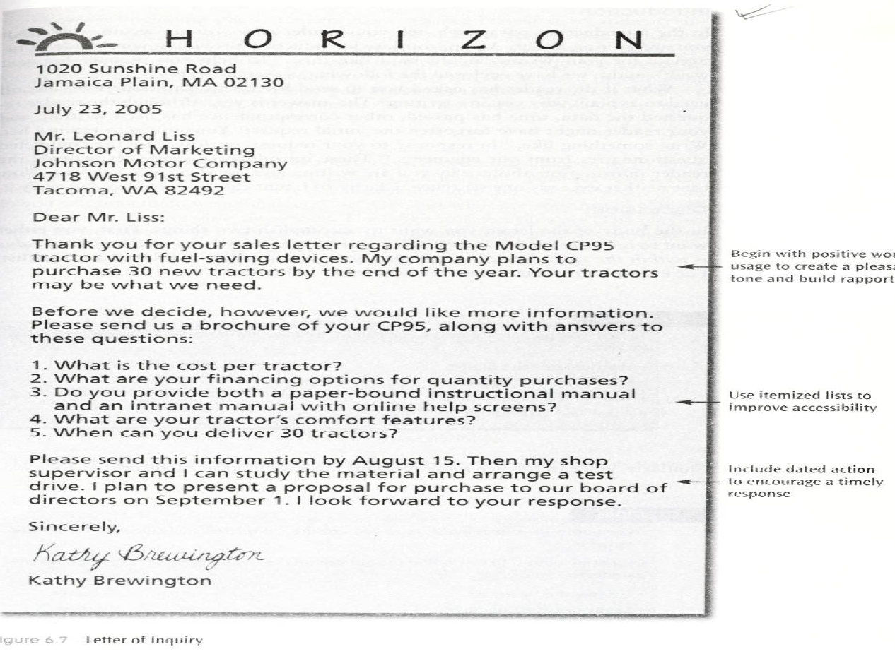

Slide 9
Cover Letters
1. Tells readers up front what they are receiving
2. Helps you focus your readers’ attention on key points within the enclosures.

Slide 10
In Introduction, write why you are writing and what you are writing about
In discussion, say what you have enclosed or exactly what of value is within the enclosures
In conclusion, say what you want to happen next, when you want this to happen, and why the data are important.

Slide 11
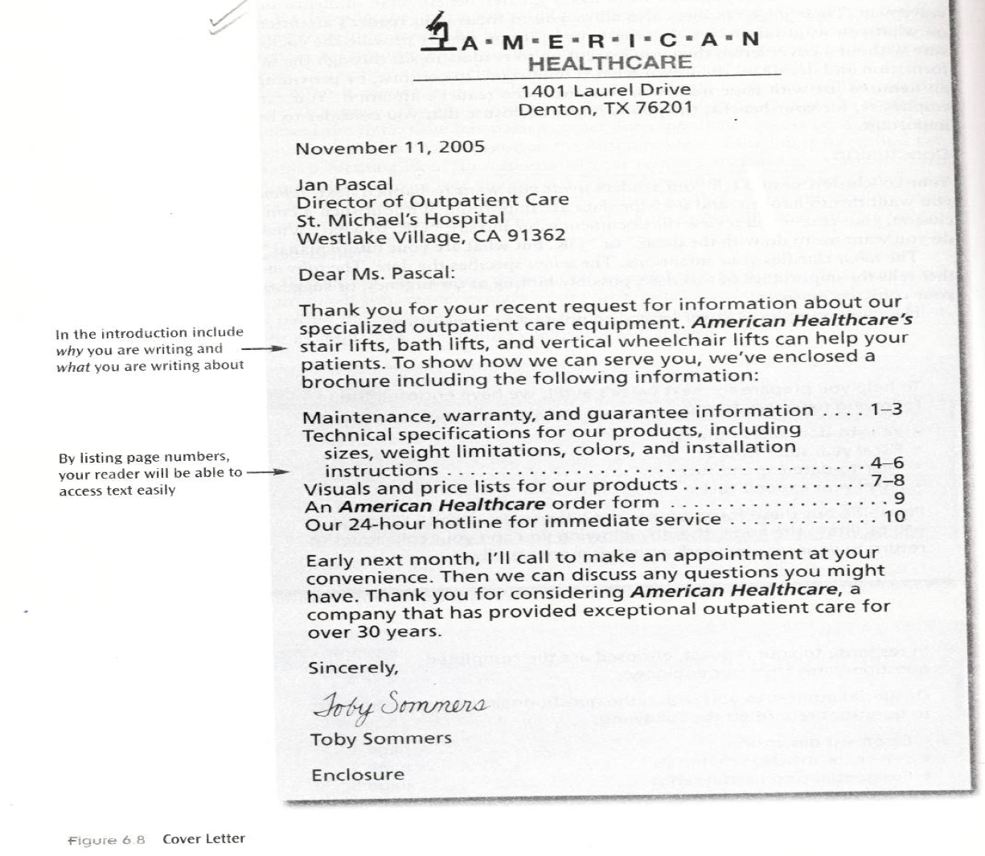

Slide 12
Good-News Letters
In Introduction, write why you are writing and what you are writing about
In discussion provide the detail – to explain exactly what has justified the commendation or the promotion
In conclusion, what you plan next, when this action will occur and why the date is important

Slide 13
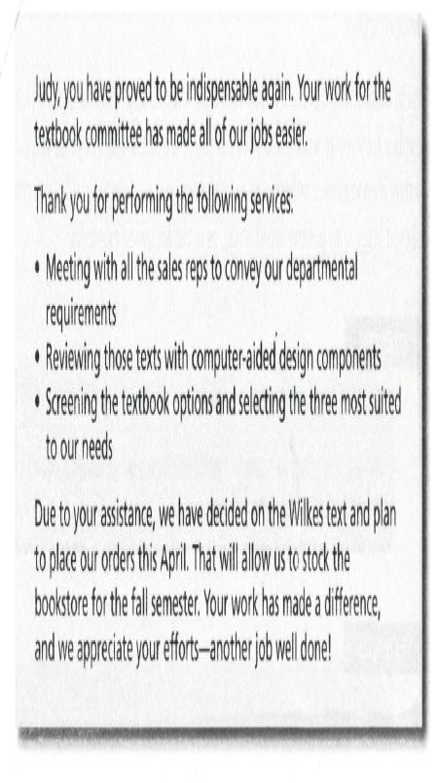

Slide 14
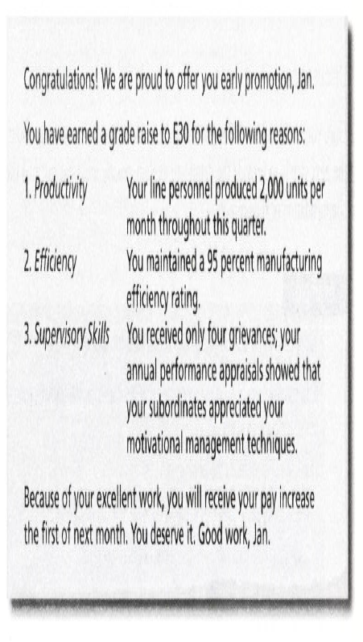

Slide 15
Bad-News Letters
Begin your bad news letter with a buffer. Start your letter with information that your reader can accept as valid.
The discussion paragraph states the bad news. For the reader to accept the bad news, preface your assertions with quantifiable proof.
Conclude by giving your reader an opportunity for future success. End on a positive note.

Slide 16
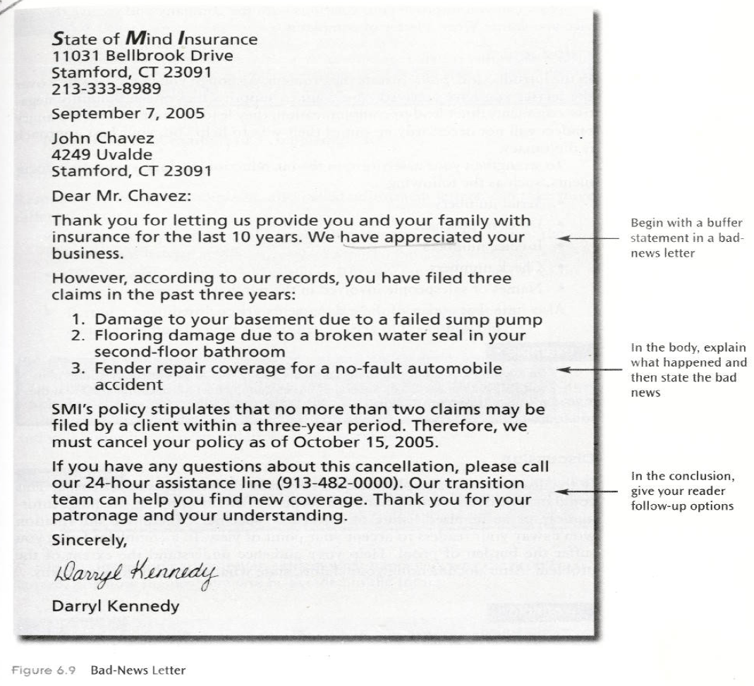

Slide 17
Negative Response to an Order
Thank you for your thorough application for the position of programmer at Unitech Microsystems and for the time you spent in interviews. We certainly enjoyed meeting you.
We regret, however, that we cannot offer you the position you seek at the present time. Our decision, made after long deliberation, is based on two factors:
1. All programmers here must often work with the UNIX operating system from the first day on the job. You have not had experience with UNIX.
2. Our programmers must often work overtime on high-priority projects. Your time commitments as a doctoral student, we feel, will make overtime impossible for you.
You must know, Mr. Sharma, that we are interested in your abilities and thank you for contacting Unitech Microsystems. Please keep us in mind as an employer when the preceding matters no longer present obstacles to our mutual association.

Slide 18
Negative Response to an Inquiry
Thank you for your letter of April 6. We especially enjoyed hearing of your research work and wish you well on its successful outcome.
We cannot, however, provide the data you requested from the army files because of national security regulations.
However, you may find interesting a recent booklet by the Army, published for civilian researchers. I enclose it for your review.

Slide 19
Assignment
Write a cover letter. Perhaps your cover letter will preface a lab report you are working on in college, a report you are writing at work, or documentation you will need to send to a client. Use the criteria for writing cover letters and the writing process techniques.

Slide 20
Assignment
Write a letter of inquiry. You might want to write to a college or university requesting information about a degree program or to a manufacturer for information about a product or service. Whatever the subject matter, be specific in your request. Follow the criteria for writing letters on inquiry and the writing process techniques.

Slide 21
Acknowledgement
All slides are adapted from Management Communication by Arthur H. Bell and Dayle M. Smith (Wiley India).

